Slide 1



Digital Sizing and Promotional Conversion Agent

Slide 2







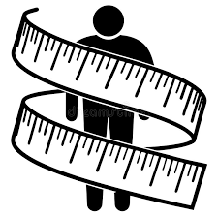


Challenge
Promotions and order management run on separate systems, limiting personalization. High return rates from incorrect sizing impact profitability and trust. As eCommerce evolves, integrating digital sizing with product context and offers can drive conversions.
Upsides
Retail Industry
In today’s fast-paced retail landscape, customer expectations are higher than ever. Shoppers want convenience, accuracy, and personalization—especially when buying apparel online. The Digital Sizing and Promotional Conversion Agent, a game-changing solution that blends artificial intelligence with customer-centric innovation.
High accuracy
Solution
An AI-powered Digital Sizing & Promotion Agent estimates body measurements from a photo, recommends accurate sizes across brands, and aligns suggestions with product availability, seasonal trends, and active offers—reducing returns and boosting conversions
Privacy First
Image Upload
AI Size detection
Smart Product Matching
Applies best available deals
Purchase Successful
Case Study Document
2
© 2025 Cognizant
@2025 Cognizant

